Slide 1
Active learning to detect DDoS attack using ranked features Jul 2019 Computer Communications 31 citations
Rohullah Jahanafrooz
1401/09/20

Slide 2
Intro
High-Bandwidth networks ➔ high-dimensional datasets ➔ Variety of traffic characteristics/pattern ➔ feature extraction is difficult ➔ traffic classification ➔ defense
Our method
feature-ranking algorithm is needed
Active Learning approach for selecting lowest appropriate samples (semi-supervised) to train SVM binary classifier.(dynamic classifier)
In evaluation, we have evaluate five different DL classifier

Slide 3
Classification approaches
Port-based: fast but not so accurate
DPI: accurate but time-consuming
Statistical Approaches: uses packet headers
Supervised Machine Learning: time-consuming to train with labled datasets
Semi Supervised: Active Learning: training dataset is repeatedly updated by a learning process that analyzes unlabeled samples to select most informative patterns by use of an expert that assign labels to them.

Slide 4
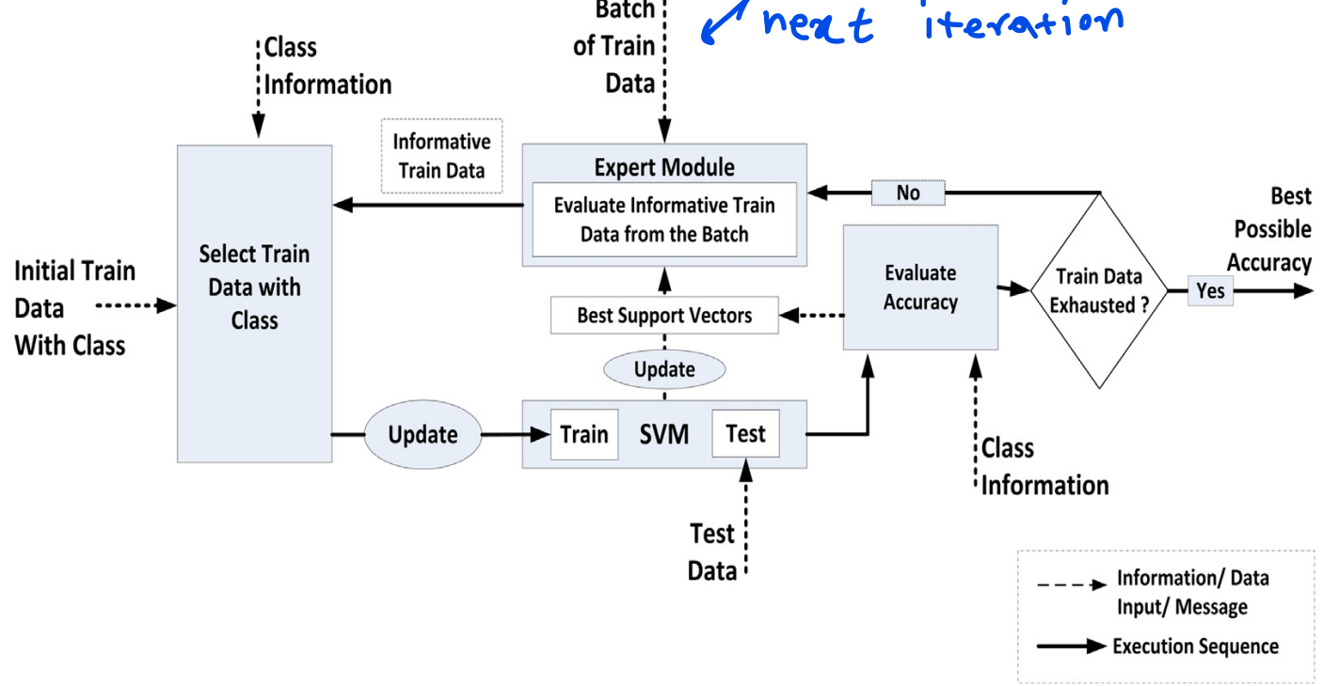
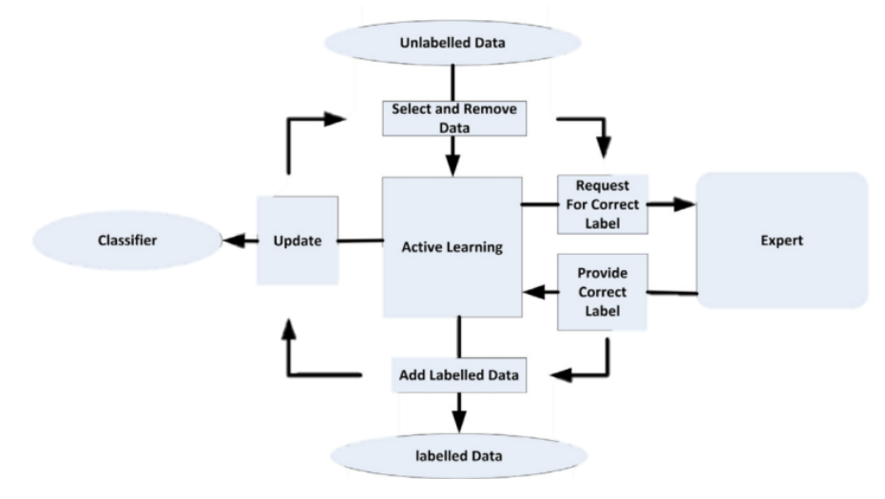
Active Learning
framework

